Slide 1
MEXICO PEACE INDEX 2023
Overview & key findings

Slide 2
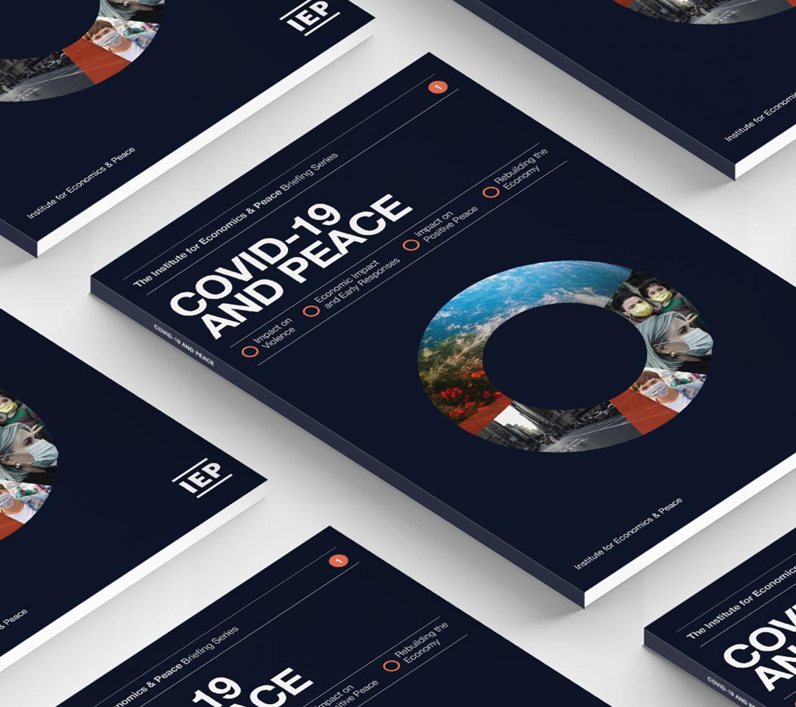
The Institute for Economics and Peace is an independent, not-for-profit think tank dedicated to building a greater understanding of the key drivers of peace, as well as identifying the economic benefits that increased peacefulness can deliver.

Slide 3
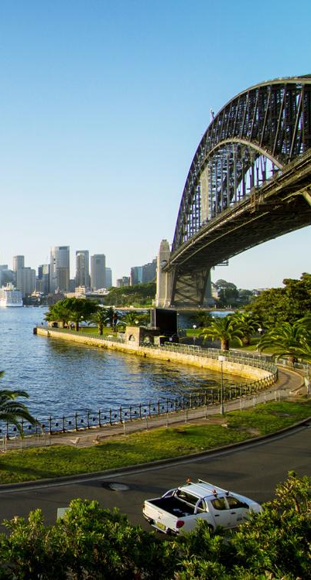
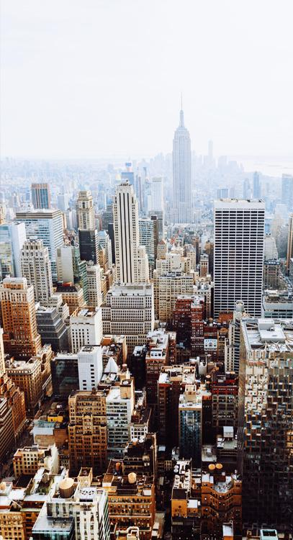
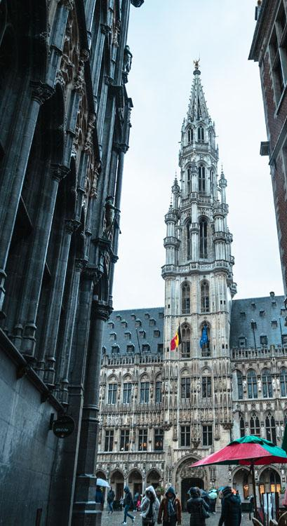
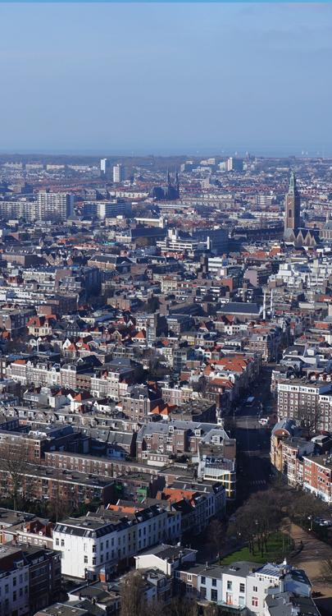
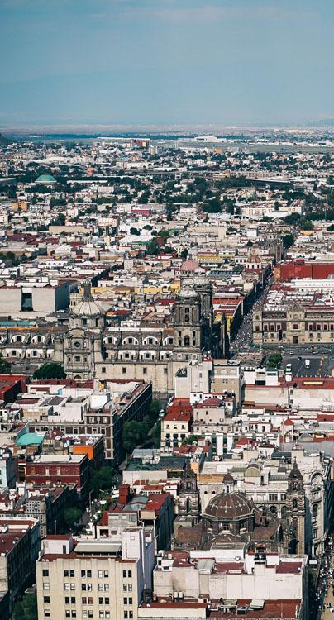
Our international offices
SYDNEY
NEW YORK
BRUSSELS
THE HAGUE
MEXICO CITY
HARARE
Australia
USA
Belgium
The Netherlands
Mexico
Zimbabwe

Slide 4
Institute for Economics & Peace
Research used extensively by organizations such as the OECD, the World Bank and the United Nations
28BN
1.4BN
152
MEDIA REACH
SOCIAL REACH
COUNTRY REACH
Work is included in thousands of university courses
10
3000
1.3M
Over 350,000 downloads of IEP reports
PUBLISHED REPORTS
BOOK REFERENCES
UNIQUE VISITORS

Slide 5
01.
Overview

Slide 6
The Mexico Peace Index
Ranks
Using
Now in its
32
5
10th
year
States according to their relative levels of peace
Indicators weighed on a 1-5 scale
Highlights issues of data quality and transparency
Associated research on the drivers of peace in Mexico, Positive Peace and the Economic Impact of Violence
Used by civil society and government

Slide 7
Key Findings
In 2022, peacefulness in Mexico improved by 0.9 percent. This was the third consecutive year of improvement following sharp deteriorations in peacefulness from 2015 to 2019.
The improvement in 2022 was driven by a sizable reduction in homicides, with the national rate falling by 7.9 percent, the largest drop since at least 2015.
Despite these improvements, the homicide rate remains high, at 24.5 deaths per 100,000 people, resulting in about 32,000 victims. This equates to approximately 87 killings per day.
Organized crime continues to drive high levels of homicide in Mexico. The states that recorded the largest deteriorations in their homicide rates were home to ongoing conflicts between cartels.
The economic impact of violence in Mexico was 4.6 trillion pesos (US$230 billion) in 2022, equivalent to 18.3 percent of the country's GDP.

Slide 8
02.
Results &
Eight-Year Trends

Slide 9
Changes in Peacefulness by Indicator, 2022
In 2022, peacefulness in Mexico improved by 0.9%, marking the third consecutive year of improvement.
Three out of five MPI indicators improved in 2022. They were homicide, firearms crime and detention without a sentence.
The organized crime and violent crime indicators deteriorated, driven by rising rates of extortion, sexual assault, family violence, and retail drug crimes.
Source: IEP

Slide 10
Changes in peacefulness in Mexico, 2015-2022
Mexico’s peacefulness has deteriorated by 14.8% over the last eight years.
After recording large deteriorations in peacefulness between 2015 and 2019, peacefulness has improved in each of the past three years.

Slide 11
Homicides, 2015-2022
Over the past eight years, there have been about a quarter million homicides in Mexico.
Between 2015 and 2019, the homicide rate experienced a dramatic rise, nearly doubling from 15.1 to 28.2 deaths per 100,000 people.
In the past three years, there has been a modest but steady decline in killings. The rate stood at 24.5 deaths per 100,000 people in 2022.
The monthly homicide rate peaked in July 2018 at 2.52 deaths per 100,000 people, and it began to experience substantial declines beginning in mid-2021.

Slide 12
Homicides associated with organized crime, 2015-2022
Organized criminal groups have driven the rise in homicides over the past eight years.
Between 2015 and 2022, the number of organized crime-related homicides rose from about 8,000 to well over 20,000.
In contrast, the number of homicides not linked to organized crime has shown relatively little change, consistently hovering between 10,000 and 12,500 per year.
In 2015, clashes involving at least one of the two most powerful cartels in the country – the Sinaloa Cartel and the CJNG – accounted for 42 percent of all cartel conflict deaths, but by 2021 they accounted for 95 percent of such deaths.

Slide 13
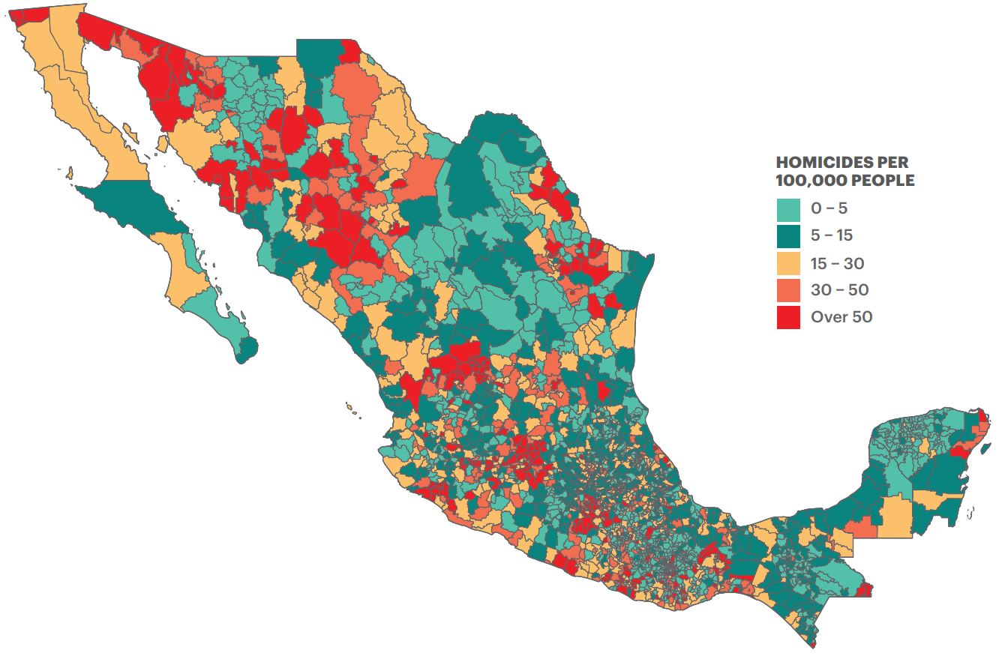
Geographic concentration of homicides in Mexico
MUNICIPAL HOMICIDE RATES, 2022
Homicides have become increasingly concentrated in certain areas in Mexico.
There is a growing divergence between states and municipalities with extreme homicide rates and those with more low or moderate homicide rates.
About 2% of Mexico’s municipalities have a homicide rate above 50 deaths per 100,000 people, while about 40% have a rate below five deaths per 100,000 people.
Last year, Colima recorded the highest homicide rate of any state in the history of the MPI, with 110 deaths per 100,000 people. As a result, it also recorded the worst peace score on record in 2022.

Slide 14
Homicide patterns by sex
Men are much more likely than women to be victims of homicide in Mexico, consistently accounting for nearly nine in ten victims over the past eight years.
Both male and female homicides peaked in 2019. However, while the killings of men have since fallen substantially, by 12.2 percent, the killings of women have only dropped by 1.8 percent.
The majority of both male and female homicides in Mexico are carried out with firearms. However, the gender-based killings of women known as femicides display different patterns, with “other means” such as beatings and strangulations being more common.
Since 2015, nearly one in four female homicides occurred in the home, compared to one in 11 for male homicides.

Slide 15
Trends in gun violence
In the past eight years, more than 160,000 people have been killed with a gun in Mexico.
The share of homicides committed with a firearm rose from 57.4 percent in 2015 to 68.6 percent in 2022.
Despite the net increase in the rate of firearms crime since 2015, both homicides and assaults carried out with firearms have been declining over the past three years.
Both sub-indicators peaked in 2019; firearms assaults have since declined by 23.7 percent and firearms homicides by 13.5 percent.

Slide 16
Indexed trend in organized crime offenses, 2015-2022
The organized crime rate has increased by 64.2% since 2015. The greatest deterioration occurred for the rate of retail drug crimes, which has increased by 149%.
Between 2019 and 2022, the number seizures of fentanyl at the Mexico-US border increased by 300%, while the number of seizures of all other drug types either decreased or remained largely unchanged.
Between 2015 and 2022, the volume of fentanyl seized at all US points of entry rose from 31.8kgs to 6,668kgs, while the volume of marijuana seized fell by 95%.

Slide 17
Indexed change in violent crime rates, 2015-2020
The rates of family violence and sexual assault deteriorated in each of the past eight years. As a result, the rates of both have more than doubled since 2015.
In contrast, the annual rates of robbery and assault have remained comparatively unchanged since 2015, never moving more than 35% above or below their 2015 levels.

Slide 18
Detention without a sentence
Detention without a sentence, which represents the ratio of unsentenced detainees relative to levels of homicide and violent crime, is the only indicator to have improved in the last eight years.
The raw number of unsentenced detainees fell from over 80,000 in 2015 to about 60,000 in 2019.
However, the partial shutdown of criminal courts during the first few months of the COVID-19 pandemic led to a significant increase in the number of unsentenced detainees in 2020.

Slide 19
03.
Economic Value of Peace

Slide 20
Trend in Economic Impact of Violence, 2015-2022
The economic impact of violence in Mexico was 4.6 trillion pesos (US$230 billion) in 2022, equivalent to 18.3% of the country's GDP.
For the third year in a row, the economic impact of violence improved, decreasing by 5.5% or 271 billion pesos from the previous year.
The economic impact of violence was 35,705 pesos per person in 2022, more than double the average monthly salary in Mexico.

Slide 21
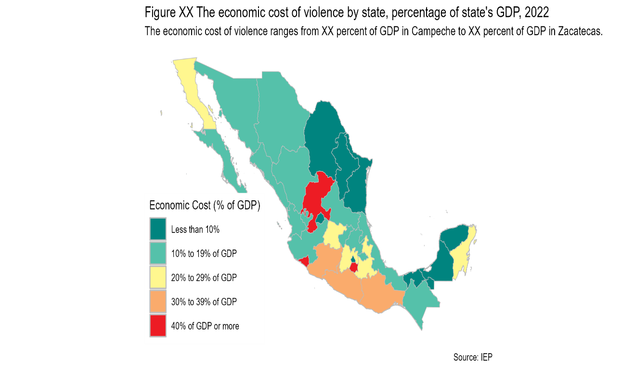
The economic cost of violence by state, 2022

Slide 22
Government spending on violence containment, 2007-2022
Spending on public order and safety has decreased over the last few years, while spending on the military has increased substantially, peaking in 2021.
Spending on domestic security decreased by 41.3 percent from 2015 to 2022, while spending on the justice system decreased by 7.9 percent.
In contrast, military expenditure grew from 134 billion pesos to 161 billion pesos between 2015 and 2022.

Slide 23
Domestic security and justice system spending in OECD countries, percentage of GDP

Slide 24
Breakdown of economic impact of violence, 2022
Homicide accounted for 45% of the economic impact of violence, at 2.1 trillion pesos (US$103 billion) in 2022.
Following the onset of the COVID-19 pandemic, the amount of money spent by businesses to protect themselves against crime dropped significantly, with such expenditures falling by 51% or 76 billion pesos between 2019 and 2021.
Between 2015 and 2022, the impact of increased homicides resulted in a loss of 324 billion pesos (US$16 billion) in foreign direct investment.

Slide 25
State MPI score and per capita expenditure on domestic security and justice, 2022
The per capita economic impact varies significantly across states last year, ranging from 11,377 pesos in Yucatán to 102,659 pesos in Colima.
States such as Baja California, Michoacán, Chihuahua and Guanajuato experience high levels of violence yet have a below-average per capita spending on domestic security and justice.
In contrast, Campeche is relatively peaceful yet dedicates an above-average level of per capita spending on domestic security and justice.
← Less Peaceful
More Peaceful →

Slide 26
04.
Positive Peace

Slide 27
Positive Peace in Mexico, 2009-2022
Mexico’s Positive Peace score has worsened by 3.1% since 2009.
The deterioration was driven by four Pillars of Positive Peace: Well-Functioning Government, Low Levels of Corruption, Sound Business Environment and High Levels of Human Capital.
This deterioration contrasts with an average improvement of 1.2% among Mexico’s neighbors in the wider Central America and the Caribbean region.

Slide 28
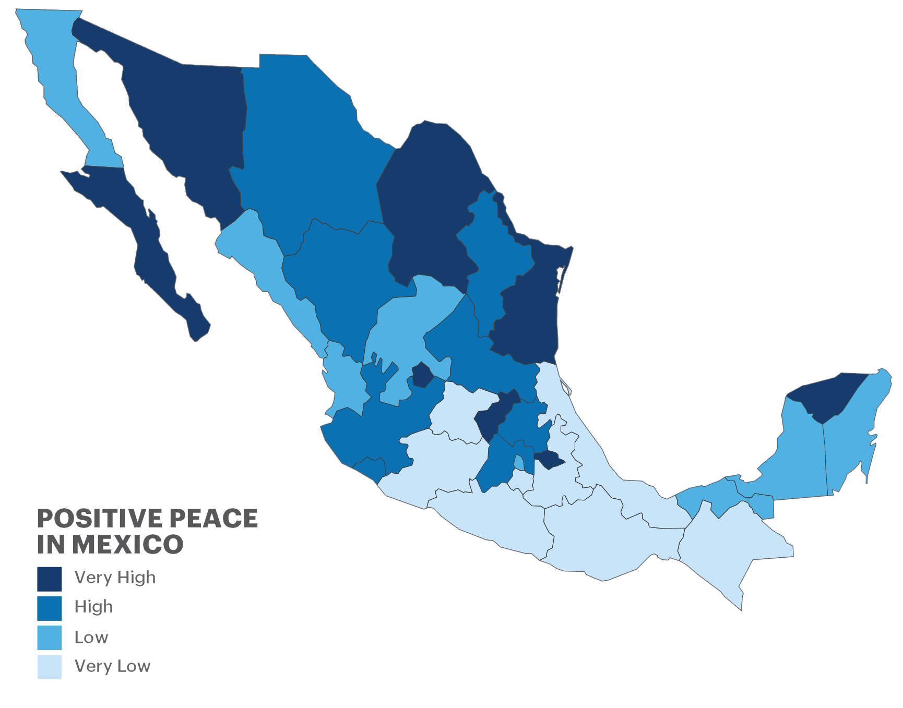
Positive Peace by state, 2020
The sub-national Mexico Positive Peace Index (MPPI) showed substantial variation across Mexico’s states.
Querétaro, Baja California Sur and Aguascalientes had the strongest levels of Positive Peace, while Guerrero, Oaxaca and Morelos had the weakest.

Slide 29
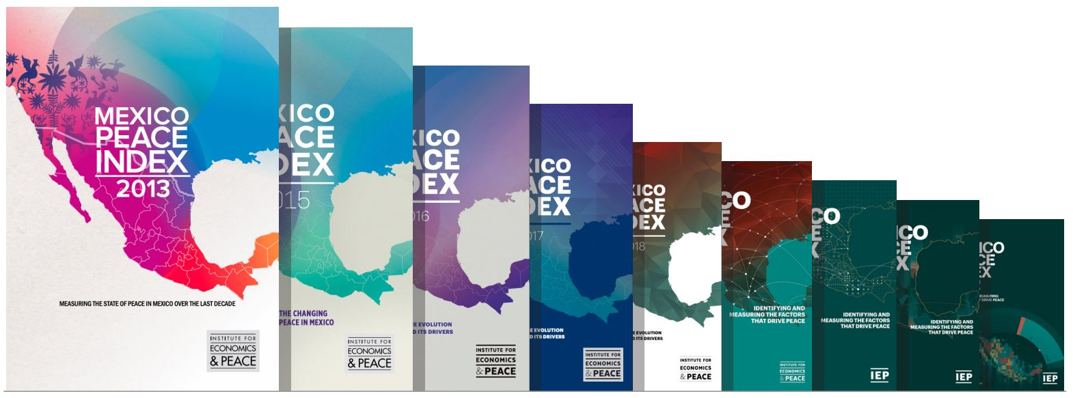
A decade of measuring and promoting Positive Peace
The MPI was first launched in 2013, as Mexico was entering its seventh year of its war on drugs. Since then, the dynamics of peace and violence in the country have changed substantially.
Rather than exclusively focusing on violence containment through public force, the MPI promotes Positive Peace, which emphasizes the attitudes, institutions and structures that create and sustain peaceful societies.
Based on this platform, IEP has offered training in Positive Peace to thousands of stakeholders across Mexico over the past decade, including more than:
4,400 public servants
3,600 members of the armed forces
2,100 police officers
5,000 university and high school students

Slide 30
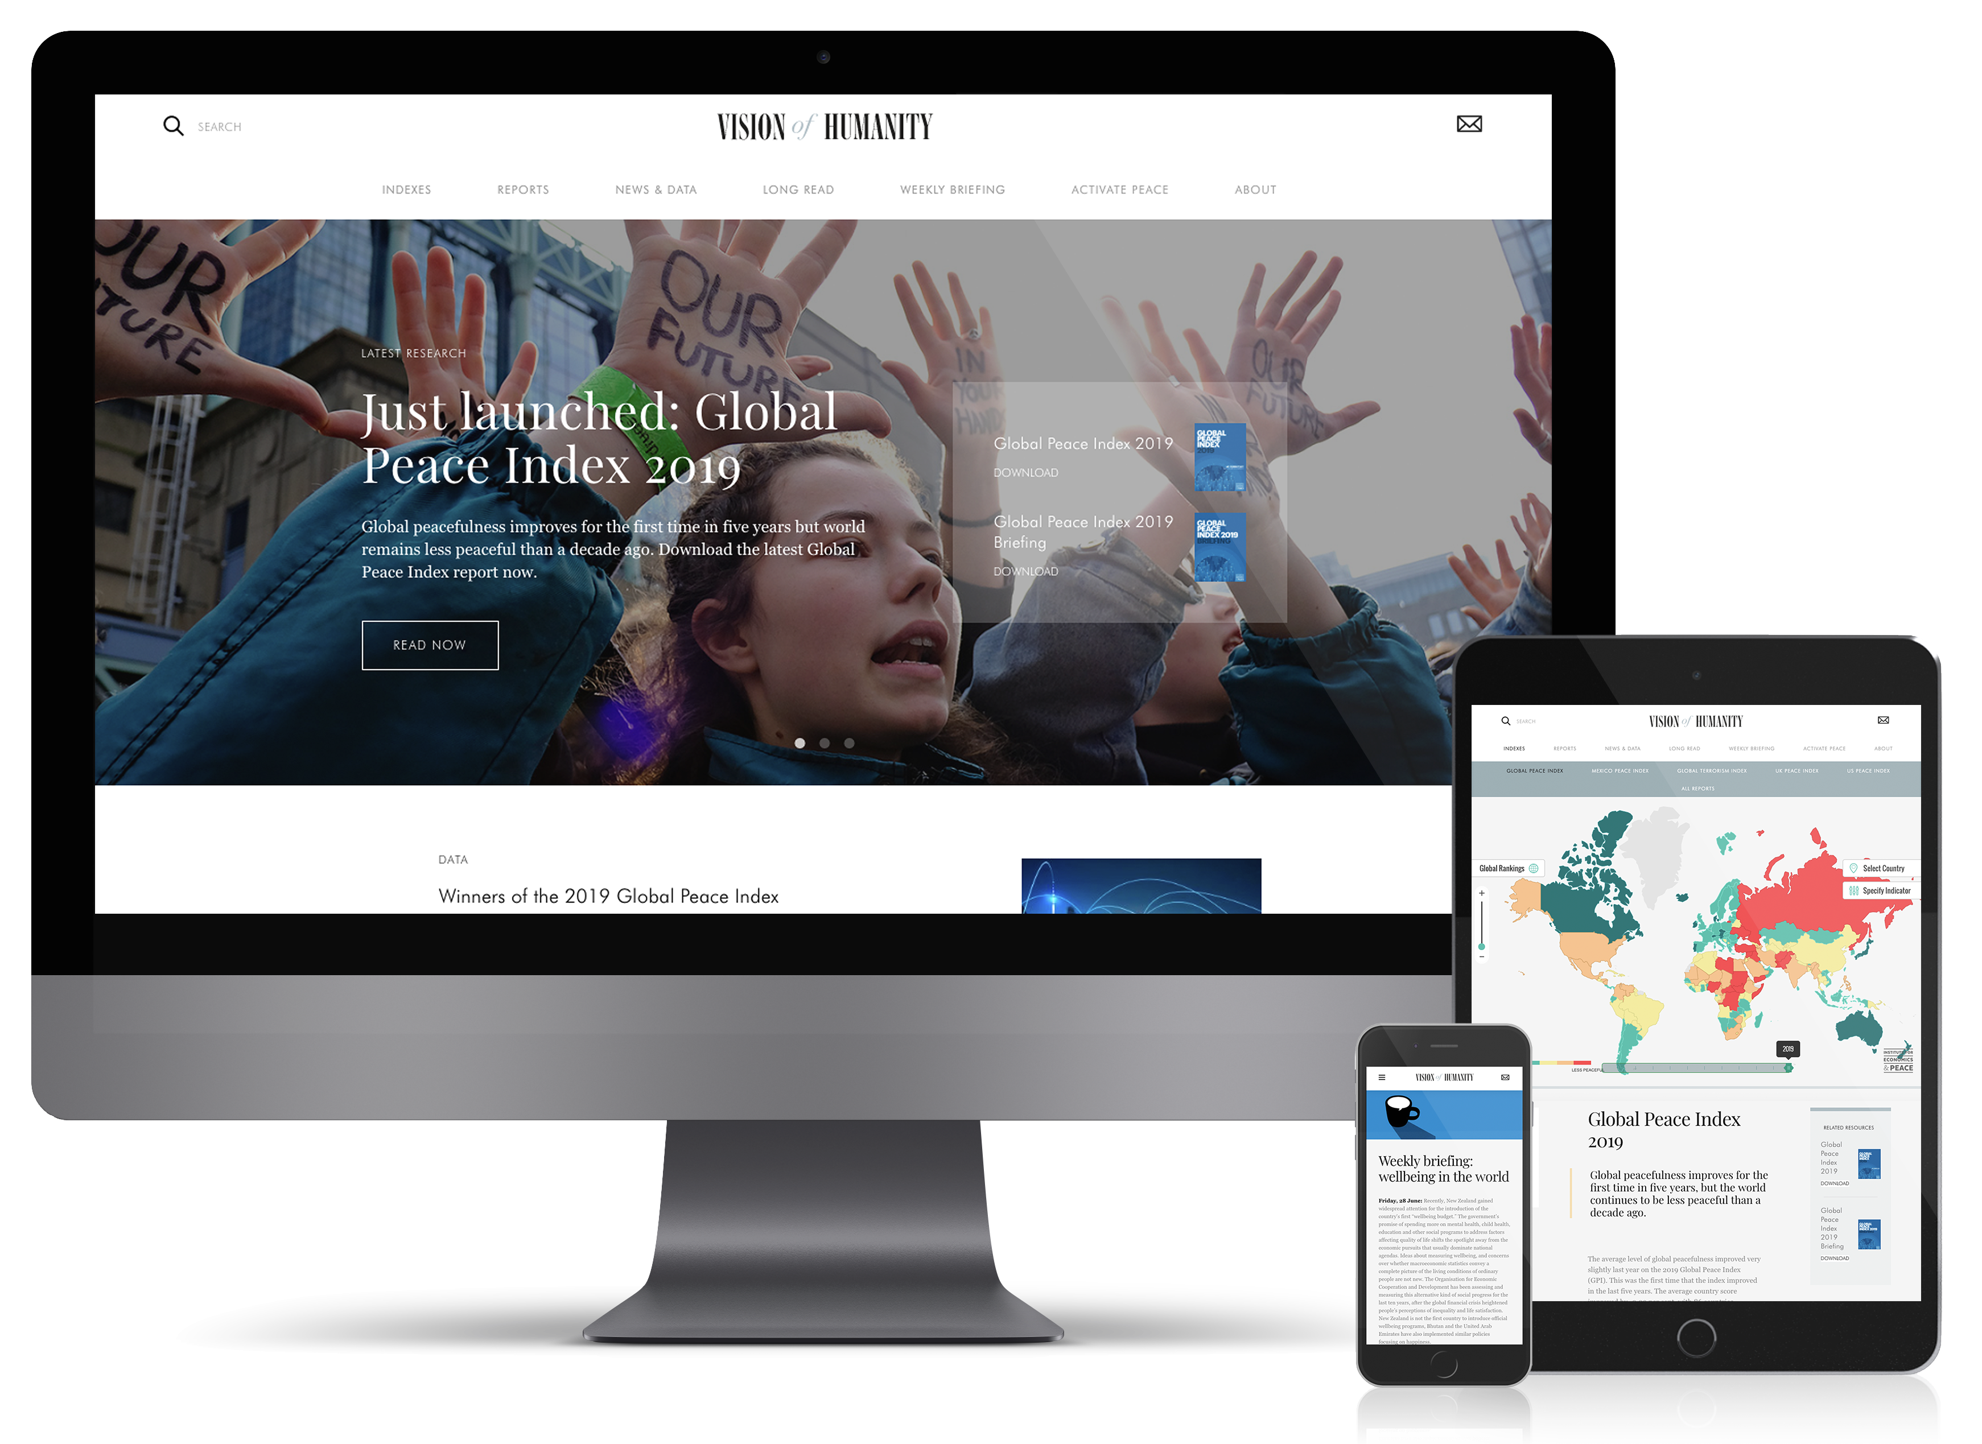
Connect with us
visionofhumanity.org
GlobalPeaceIndex
@GlobPeaceIndex
@GlobalPeaceIndex

Slide 31
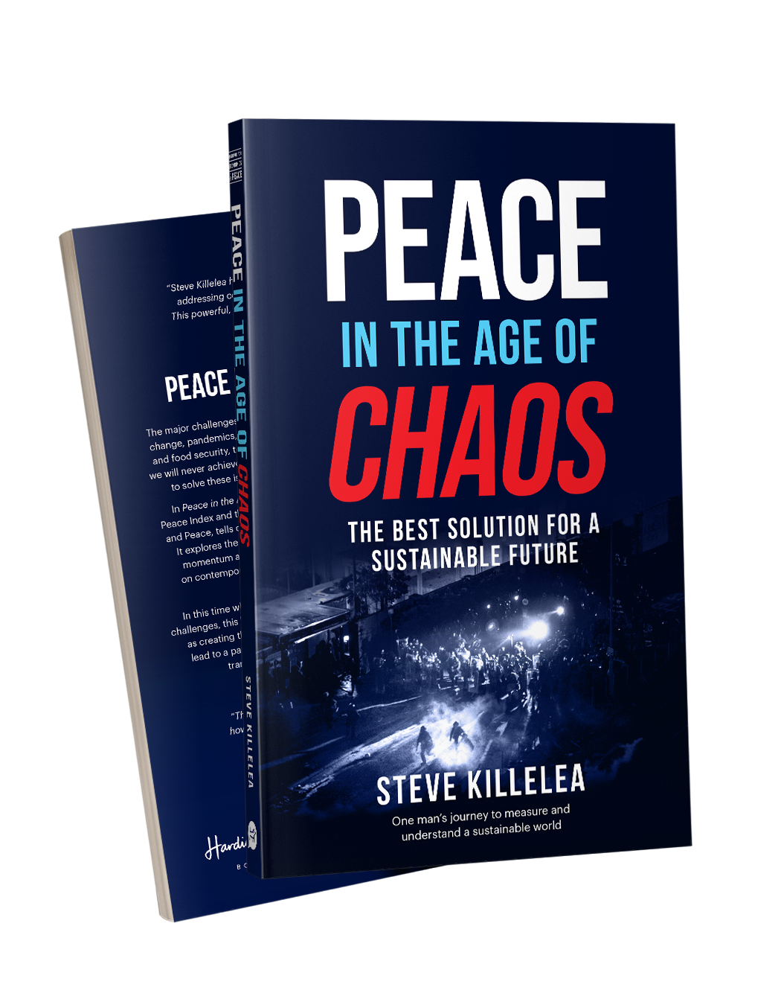
Peace in the Age of Chaos
Peace in the Age of Chaos is the debut
book by the Founder & Executive Chairman
of IEP, Steve Killelea A.M.
The book pushes the reader to rethink peace,
as something that is pivotal to the development of successful societies
Includes many personal experiences and the journey behind the founding of IEP and the Global Peace Index
Endorsed by prominent politicians,
peacebuilders and professors

Slide 32
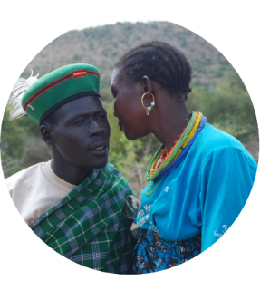
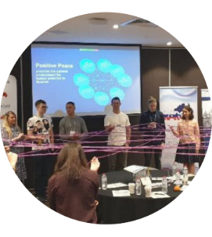
Get involved with IEP
@GlobPeaceIndex
GlobalPeaceIndex
Ambassador Program
Positive Peace Workshops
@GlobalPeaceIndex
Online
Strategic Partnerships
IEP Peace Academy
visionofhumanity.org

