Slide 1
November 2020
GLOBAL TERRORISM INDEX
2020
Measuring the impact of terrorism on the world

Slide 2

Institute for Economics and Peace
Research used extensively by organisations, including the OECD, Commonwealth Secretariat, World Bank and the United Nations.
21BN
1.1BN
150
  MEDIA REACH
SOCIAL REACH
COUNTRY REACH
Work is included in 1,000s of university courses
Over 500,000 downloads of IEP reports each year
10
3000
1.3M
PUBLISHED REPORTS
BOOK REFERENCES
UNIQUE VISITORS

Slide 3





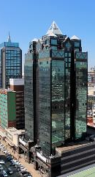
IEP International Offices
SYDNEY
NEW YORK
BRUSSELS
THE HAGUE
MEXICO CITY
HARARE
Australia
USA
Belgium
The Netherlands
Mexico
Zimbabwe

Slide 4
01.
What is
the GTI?

Slide 5
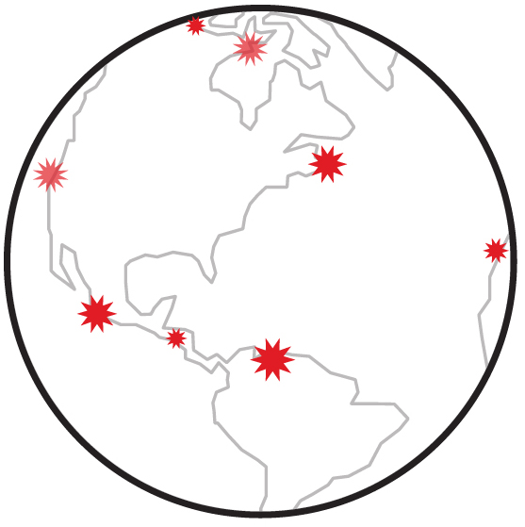
The Global Terrorism Index
Ranks
Now in its
99.7% of world’s population covered
8th
163
year
countries
Used as an indicator in the Global Peace Index
Developed by the Institute for Economics and Peace
Data sourced from the START Global Terrorism Database – University of Maryland

Slide 6


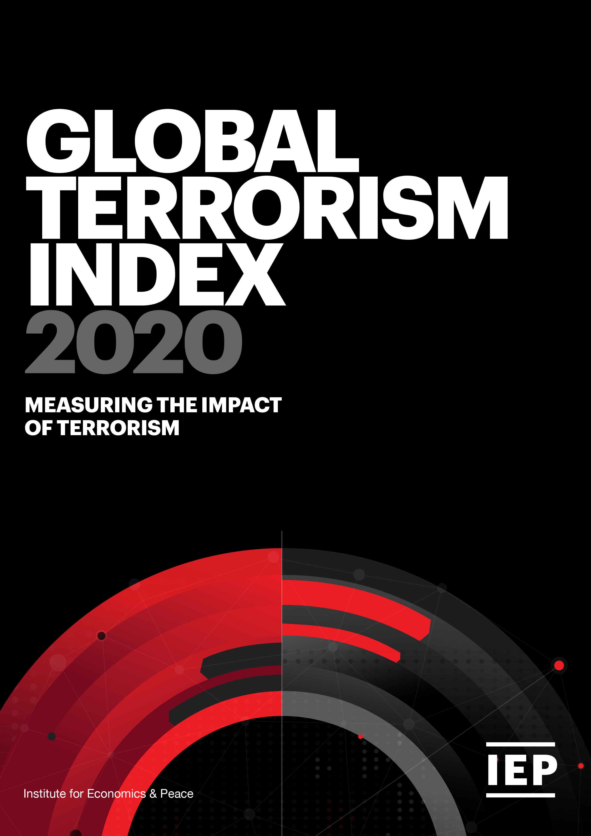
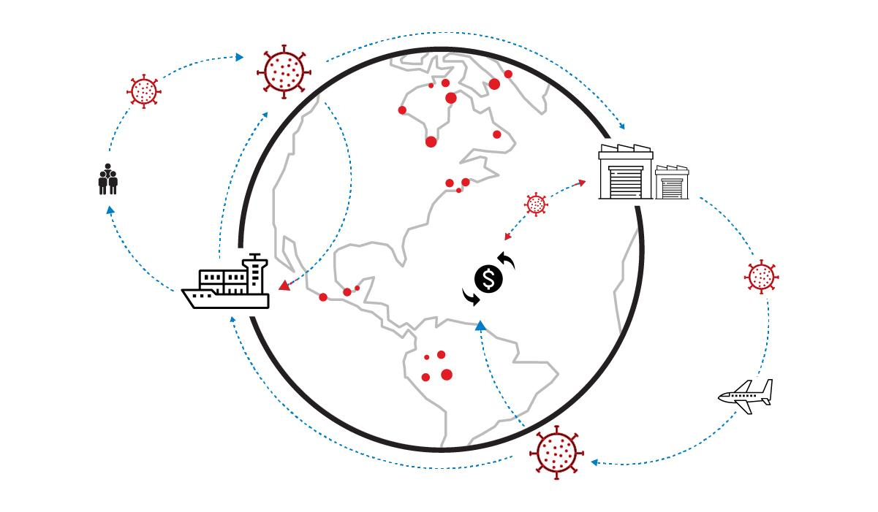
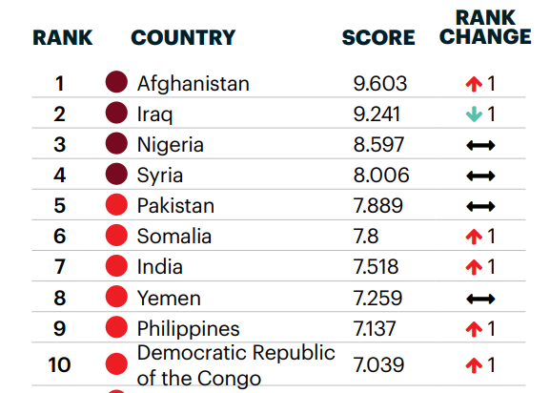
Global Terrorism Index: Methodology
Definition: the use of illegal force and violence by a non‐state actor to attain a political, economic, religious or social goal through fear, coercion, or intimidation.
    Over 5 years to measure long term impact
Indicator | Weight
Incidents | 1
Injuries | 0.5
Deaths | 3
Property Damage | 1 to 3
Year | Year minus 1 | Year minus 2 | Year minus 3 | Year minus 4
52% | 26% | 13% | 6% | 3%
    Socio-economic indicators
    Logarithmic banding scores (1-10)

Slide 7
02.
Results

Slide 8
Global Terrorism Index 2020
Key Findings
Deaths from Terrorism fall by 15% for fifth consecutive year to 13,800
ISIL core diminishes – first year where they caused less than 1,000 deaths since their inception
Far-right terrorism increases 250% in last five years- from low base
Deaths fall in the 4 countries with most deaths
ISIL centre of gravity shifts to sub-Saharan Africa – 7 of 10 largest increases in SSA
ISIL affiliates launch attacks in 27 countries

Slide 9
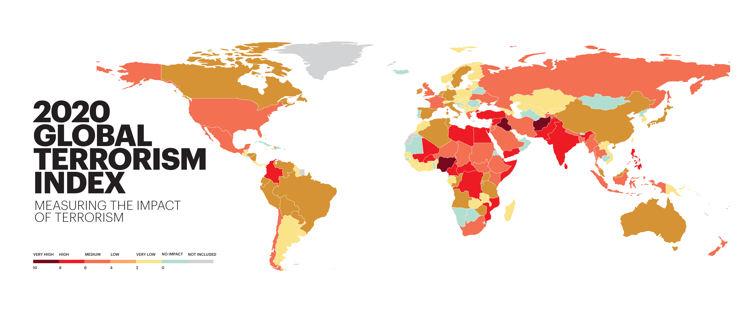
Global Terrorism Index 2020

Slide 10
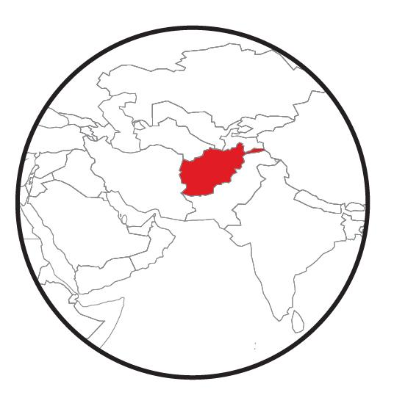
The Countries Most Impacted by Terrorism, 2020 GTI
Afghanistan recorded the highest impact of terrorism for the second consecutive year.
1
AFGHANISTAN
Rank change:
6
YEMEN
Rank change: 1
2
7
PAKISTAN
Rank change: 2
IRAQ
Rank change:
3
NIGERIA
Rank change:
8
INDIA
Rank change:
4
SYRIA
Rank change:
9
CONGO, DRC
Rank change: 1
5
SOMALIA
Rank change: 1
10
PHILIPPINES
Rank change: 1

Slide 11
Key Findings, 2020 GTI
Terrorism has been on a downward trend since its peak in 2014
Terrorism deaths decreased by 15.5% between 2018 and 2019

Slide 12
Deaths from Terrorism by Country, 2019
Ten countries accounted for 80% of all deaths from terrorism in 2019
Source: START GTD, IEP Calculations

Slide 13
Countries – Decreases in Deaths from Terrorism in 2019
Afghanistan had the largest decrease in the number of deaths from terrorism, reversing a steady increase in terrorism deaths since 2001
Source: START GTD, IEP Calculations

Slide 14
Countries – Increases in Deaths from Terrorism in 2019
Deaths from terrorism in Burkina Faso increased six fold in 2019
Source: START GTD, IEP Calculations

Slide 15
The economic impact of terrorism, 2019
The total economic impact of terrorism in 2019 was over 26 billion dollars
Country | % of GDP | GTI 2020 Rank
Afghanistan | 16.7% | 1
Syria | 3.4% | 4
Nigeria | 2.4% | 3
Burkina Faso | 1.9% | 12
Mali | 1.9% | 11
Somalia | 1.2% | 5
Iraq | 1.1% | 2
Yemen | 1.0% | 6
Sri Lanka | 1.0% | 20
Central African Republic | 0.9% | 17
Source: IEP

Slide 16
03.
Trends in Terrorism

Slide 17
Deaths from terrorism, 2002-2019
Deaths from terrorism have decreased 59% since peaking in 2014
Source: START GTD, IEP calculations

Slide 18
Deadliest Terrorist Groups, 2002-2019
The Taliban were the deadliest terrorist group for the second consecutive year
Source: START GTD, IEP Calculations

Slide 19
Distribution of deaths from terrorism, 2002-2019
In 2019, 63 countries recorded at least one death from terrorism, the lowest number since 2013
Source: START GTD, IEP Calculations

Slide 20
Deaths from terrorism by conflict type, 2002-2019
Over 96 per cent of deaths from terrorism occur in countries currently experiencing a conflict
WAR
NON-CONFLICT
MINOR ARMED CONFLICT
Source: UCDP ACD, START GTD, IEP calculations

Slide 21
Trend in terrorism deaths by region, 2002-2019
In 2019, the number of terrorism deaths in South Asia and sub-Saharan Africa exceeded deaths recorded in MENA
2019
Source: START GTD, IEP calculations

Slide 22
04.
The Shifting Landscape

Slide 23
Deaths from terrorism by decade, 2000-2019
The last decade was the deadliest on record with over 182,000 terrorism deaths, compared to 72,000 in the 2000s

Slide 24
Trend in ISIL-related terrorism deaths, 2013-2019
Since 2013, ISIL and affiliated groups have caused over 40,000 terrorism deaths
Source: START GTD, IEP calculations

Slide 25
Number of countries recording ISIL-related attacks, 2013-2019
The number of countries recording terror attacks by ISIL-related groups has risen from two in 2013 to 27 in 2019

Slide 26
Regional distribution of ISIL-related terrorism deaths, 2013-2019
By 2019, less than a third of ISIL deaths from terrorism occurred in the MENA region
Source: START GTD, IEP calculations

Slide 27
Terrorism and ecological threats
The six countries with the greatest increase in terrorism in sub-Saharan Africa face medium to high exposure to ecological threats
Country | GTI Increase in Terrorism Rank | In Conflict? | Number of Ecological Threats | Projected Population Growth to 2050
Burkina Faso | 1 | Yes | 2 | 108%
Mozambique | 3 | Yes | 5 | 109%
Congo, DRC | 4 | Yes | 2 | 117%
Mali | 5 | Yes | 3 | 115%
Niger | 7 | Yes | 3 | 171%
Cameroon | 8 | Yes | 2 | 91%

Slide 28
05.
Far-right Terrorism & Political Violence

Slide 29
Far-right terrorism deaths and incidents in the West, 2002 - 2019
Although political terrorist incidents have increased in the last decade, the majority of deaths from terrorism in the West came from religious terrorism
Source: START GTD, IEP calculations

Slide 30
Far-right terrorist incidents in the West, 1970-2019
Far-right terrorist incidents have increased 250 per cent over the past five years
Breivik attack
Norway
2019
Source: START GTD, IEP calculations

Slide 31
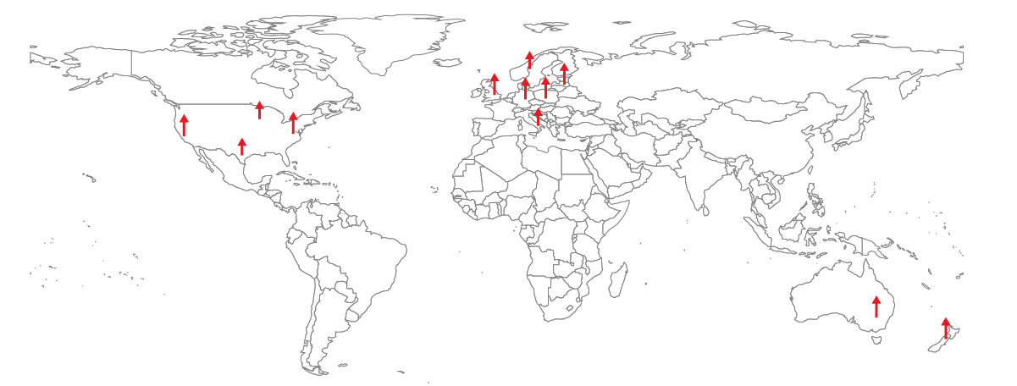
Far-right terrorist incidents in the West
250%
Increase in far-right terrorist attacks
over the past five years

Slide 32
Distribution of far-right incidents and deaths from terrorism by country, 2002-2019
The US has recorded the largest number of far-right incidents and deaths in the West
Five countries with the most incidents decreased in Positive Peace in the last two years
Source: START GTD, IEP calculations

Slide 33
Terrorist Attacks by Ideology and Affiliation, 1970-2019
Sixty per cent of far-right attacks were carried out by individuals with no group affiliation
Source: START GTD, IEP calculations

Slide 34
Mass Shootings and Terrorism in the US, 1982-2019
The proportion of mass shootings classified as terrorist attacks has been increasing
Source: START GTD, IEP calculations

Slide 35
People who feel that violence is at least partially justified in advancing political goals, U.S., 2017 – 2020
Both Democrats and Republicans are now much more likely to feel that violence for political ends is at least partially justified
Source: YouGov, Voter Study Group, Nationscape

Slide 36
Deteriorations in western attitudes
Group Quality of Fractionalised Political Press Equitable
Grievances Information Elites Democracy Freedoms Distribution

Slide 37
06.
Systems
& Terrorism

Slide 38
Terrorism has long term systematic effects that are rarely reversed
After the 9/11 attacks, internet content regulation greatly increased in the US while the deterioration in law and order has not been reversed.

Slide 39
Terrorist group survival, 2002-2019
Most terrorist groups disband, merge with other groups, or are destroyed within a year of being formed

Slide 40
Correlates of terrorism
Some factors are more strongly linked with terrorism in developing economies
GROUP GRIEVANCES VS GLOBAL TERRORISM INDEX

Slide 41


Terrorist groups flourish when they can increase their influence
Terrorist groups need motivation, recruitment, funding, and media coverage to grow
Influence
Media
Funding
Recruiting Sympathisers
Mutual reinforcing feedback loops – all need disrupting simultaneously

Slide 42




Peace in the Age of Chaos
Peace in the Age of Chaos is the debut
book by the Founder & Executive Chairman
of IEP, Steve Killelea A.M.
The book pushes the reader to rethink peace,
as something that is pivotal to the development of successful societies
Includes many personal experiences and the journey behind the founding of IEP and the Global Peace Index
Endorsed by prominent politicians,
peacebuilders and professors
Order at peaceintheageofchaos.org
or online at all major bookstores

Slide 43

Connect with us
visionofhumanity.org
GlobalPeaceIndex
@GlobPeaceIndex
@GlobalPeaceIndex

