Slide 1


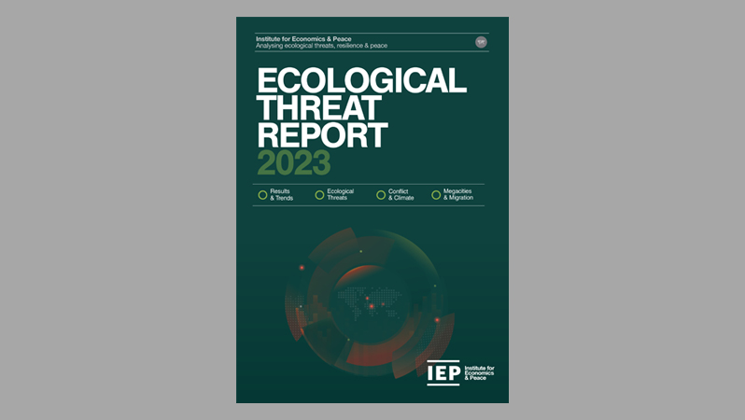
Ecological Threat Report 2023
Building peace through the power of research, consulting and training
OVERVIEW:
Key Findings
Country Hotspots
Ecological Threats
Megacities
Policy Recommendations

Slide 2

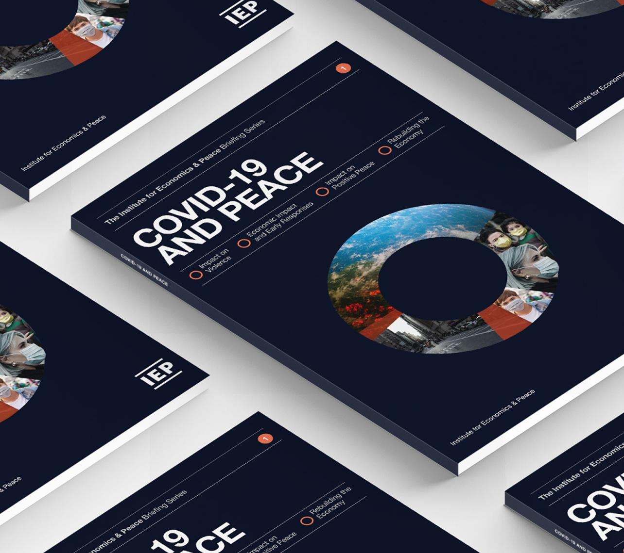
The Institute for Economics and Peace is an independent, not-for-profit think tank dedicated to understanding the intersection between business, peace and economics. It places a special emphasis on metrics to measure peace, operational programs to improve peace, and the economic benefits of peace.

Slide 3
Our international offices
Brussels
The Hague
New York
Sydney Head Office
Mexico City
Harare

Slide 4

Institute for Economics and Peace
Research used extensively by organisations, including the OECD, Commonwealth Secretariat, World Bank and the United Nations
28BN
1.4BN
152
MEDIA REACH
SOCIAL REACH
COUNTRY AUDIENCE
Work is included in 1,000s of university courses
Activities in over 30 countries last 12 months – training, workshops, consulting
10
6,000
2M
PUBLISHED REPORTS
BOOK REFERENCES
WEB VISITORS

Slide 5
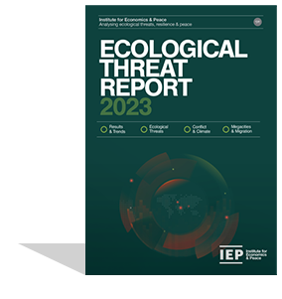
The Ecological Threat Report
Ranks
Ranks
Across
221
3,594
9
Countries and Independent States
Local Administrative Areas
Regions
99.99% of world’s population covered
Using
Sources thousands of datasets to assess ecological vulnerability, resilience and risk
4
Indicators on a 1-5 scale

Slide 6
The Ecological Threat Report
4
domains
1
billion people
30
hotspot countries
Food Insecurity
Water Risk
Demographic Pressure
Natural Disasters
Living in countries with low societal resilience and high ecological threat
Countries with the highest ecological threats and lowest resilience

Slide 7
01.
Key
Findings

Slide 8
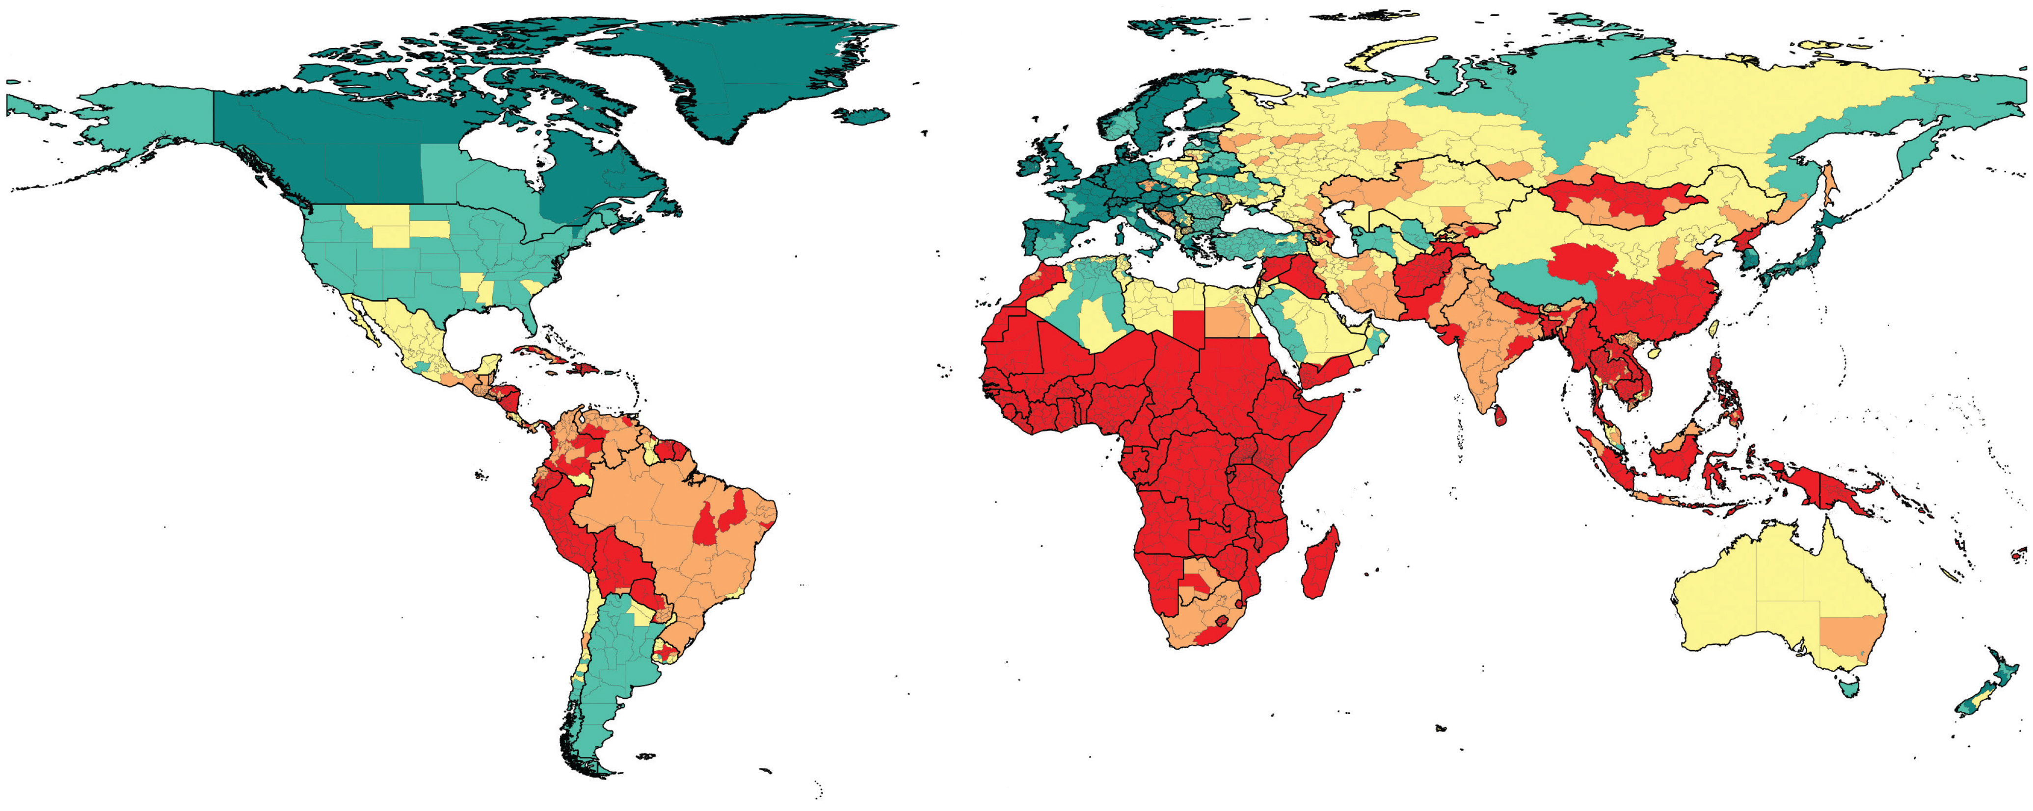
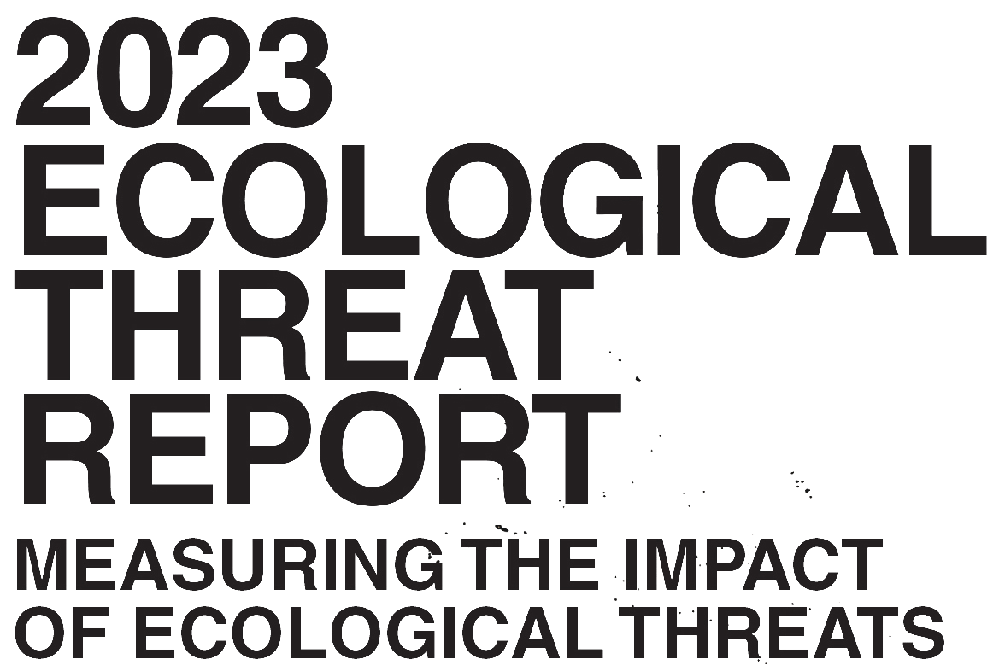
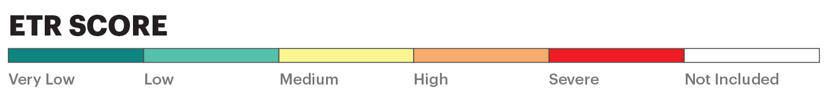
Ecological Threat Report Subnational Scores, 2023
Source: IEP

Slide 9
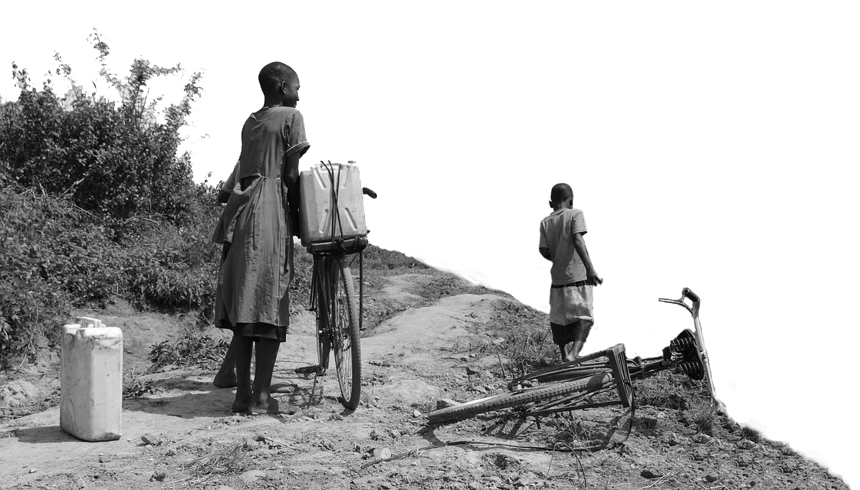

2023 key highlights
    In 2023, 66 countries home to
1.8 billion
    By 2050, the same 66 countries will have
people face severe ecological threats.
    2.8 billion
    56%
From today

Slide 10

2023 highlights
    Ecological threats, violence and conflict are closely associated, forming vicious cycles.
    As ETR scores worsen peacefulness deteriorates – without societal resilience.
    The world’s 40 least peaceful countries will increase their population by 1.3 billion people by 2050, accounting for almost half the world population.
    Each of the least peaceful countries are also facing at least one severe ecological threat.
    Over 1 billion people live in areas from facing food insecurity. This number could double by 2050.
    The world’s fastest growing megacities are the least capable of managing growth.
    Countries with high societal resilience are more likely to meet their ecological challenges.

Slide 11
2023 highlights…cont’d
    Sub Saharan Africa is facing the biggest challenges
    42 of the 52 countries in the region face severe water stress.
    Over 76% of all people facing severe food insecurity are in sub-Saharan Africa.
    The population of sub-Saharan Africa is projected to increase by almost 62% by 2050, from 1.34 billion to 2.16 billion.
    Of the ten largest megacities in the region, nine are in countries facing at least one severe ecological threat other than population growth.
    Nearly two-thirds of the 30 hotspot countries are in sub-Saharan Africa.

Slide 12
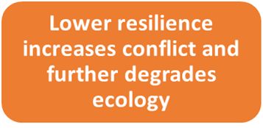
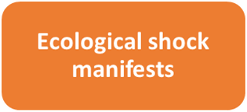

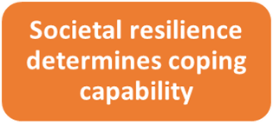
Resilience at Risk
Reoccurring, compounding, or high impact threats have the potential to disrupt or break down a country's level of resilience.
Ecological health

Slide 13
2023 highlights – continued
    The distribution of ecological threat severity.
    66 countries score severe
    33 countries score high
    56 countries score medium
    23 countries score low
    43 countries score very low
Source: IEP

Slide 14
ETR SCORE – Average by region
Source: IEP Calculations

Slide 15
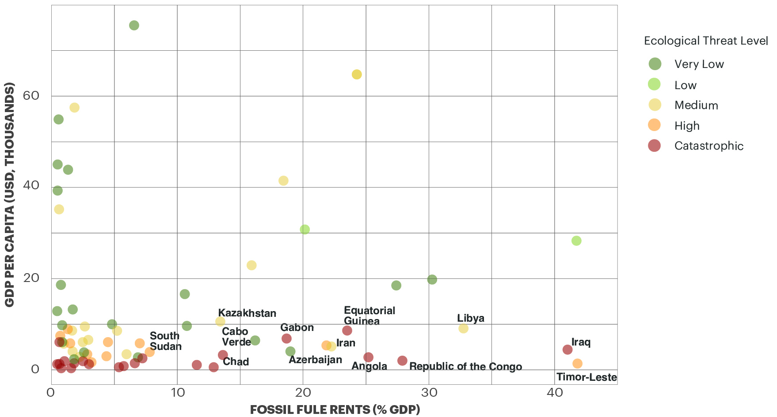
Ecological Threat and the Green Transition
    Efforts to keep global temperatures below a 1.5-degree Celsius increase require a massive shift from fossil fuels to zero carbon emissions energy sources.
    This shift is essential for global emission goals but challenging for countries that are dependent on fossil fuel revenues.
      40 countries rely heavily on these revenues.
      According to the UNDP, these nations could face losses of over 60% of their current GDP by 2040 under a net-zero 2050 scenario.
      This loss, combined with limited opportunities for economic diversification and ecological threats, might lead to significant social and economic disruptions.
Source: World Bank; IEP Calculations

Slide 16
02.
Country Hotspots

Slide 17
Resilience and Hotspot Countries
    The 30 countries with the lowest Positive Peace and severe ecological threats are home to 1.1 billion people.
    Positive Peace shows high statistical associations with improved levels of food security, water security and the ability to manage natural disasters.
    The ETR uses Positive Peace and the worst ETR scores to identify countries where resilience is unlikely to be strong enough to adapt to shocks – hotspot countries.
    30 hotspots countries face extreme ecological threats and low societal resilience – home to over 1.1 billion people.

Slide 18
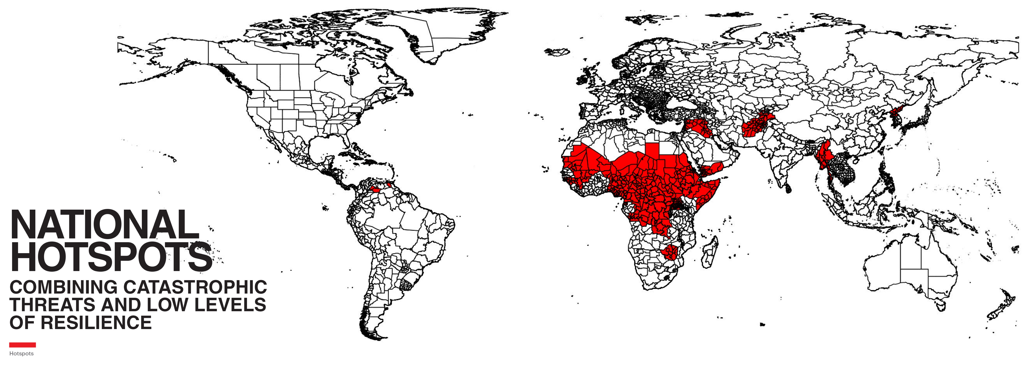
ETR Subnational Hotspots, 2023
Source: IEP Calculations

Slide 19
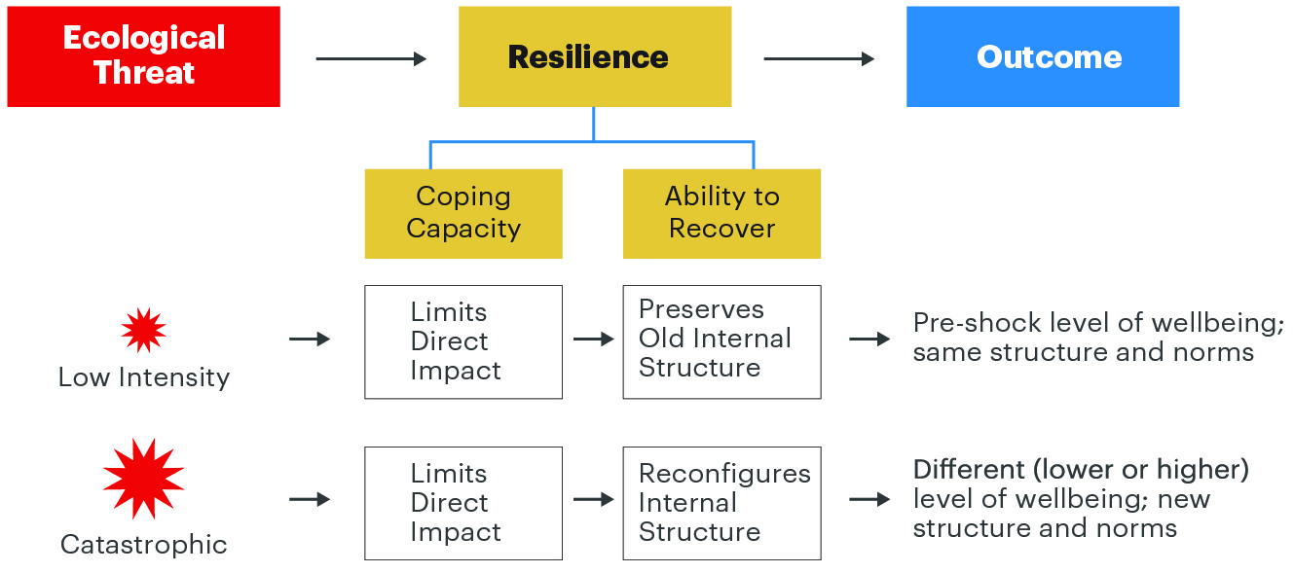
Resilience involves coping with and recovering from shocks
Resilient societies can cope with higher level shocks, learning from the shocks to improve future outcomes.
A severe ecological threat may prompt the system to change its internal structures and norms.
Source: IEP

Slide 20
2023 highlights – Hotspots
    103 sub-national areas face severe threats in all four domains. They are home to 217 million people.
    Four worst sub-national areas by population
Country | Region | Sub-national Areas | Location | Description | 2023 Population
Ethiopia | sub-Saharan Africa | Oromia | Central | Largest region in Ethiopia by population and area. | 34,482,294
Niger | sub-Saharan Africa | Maradi | South | Most populous region in Niger. | 7,106,950
Niger | sub-Saharan Africa | Zinder | South | Second most populous region in Niger. | 6,673,394
Ethiopia | sub-Saharan Africa | Somali | East | Second largest region in Ethiopia by area. | 6,532,213
Source: IEP

Slide 21
03.
Ecological Threats

Slide 22
Food Security – Key Findings
    Forty-two countries face severe food insecurity
    1 billion people live in countries with severe food insecurity – more than 65% of the population were unable to afford food at least once last year.
    Sub-Saharan Africa has the largest proportion of its population living in areas with severe food insecurity at 85%
    35 of the 52 countries and territories in sub-Saharan Africa suffer from extreme food insecurity.
    Food insecurity is both a cause and consequence of conflict, especially in areas with weak institutions and low resilience

Slide 23
Global Food Prices, 1992-2022
The food price index is currently 33% higher than in 2016.
Source: FAO; IEP Calculations

Slide 24
Population living in areas with severe food insecurity, 2023 to 2050
Food insecurity is higher in sub-Saharan Africa than any other region, and will get worse if left unchecked.
Source: WPP; IEP Calculations

Slide 25
Water Risk
    Water and food are intrinsically related. Lack of water leads to lack of food.
    2 billion people globally live in areas without access to safe drinking water. 3.6 billion people lack access to safe sanitation.
    Sub-Saharan Africa, South Asia and South America suffer from the worst water stress.
    Water scarcity is expected to worsen in numerous countries in the Russia and Eurasia region by 2040. This could have a significant impact on agriculture in the region.
    The number of countries using more than 80% of their renewable water supply for irrigation, livestock, industry, and domestic purposes has risen from 17 in 2019 to 25 in 2023.
    Damming is a major issue for downstream countries – 300M dependent on Mekong, 200M dependent on the Nile. Water-sharing arrangements remains a source of tension in these regions.

Slide 26
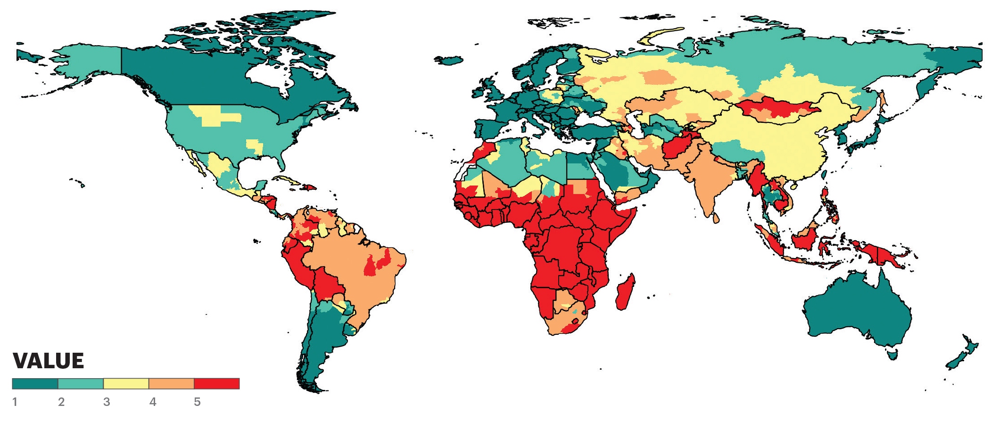
Subnational Water Risk, 2023 ETR
Source: World Resources Institute

Slide 27
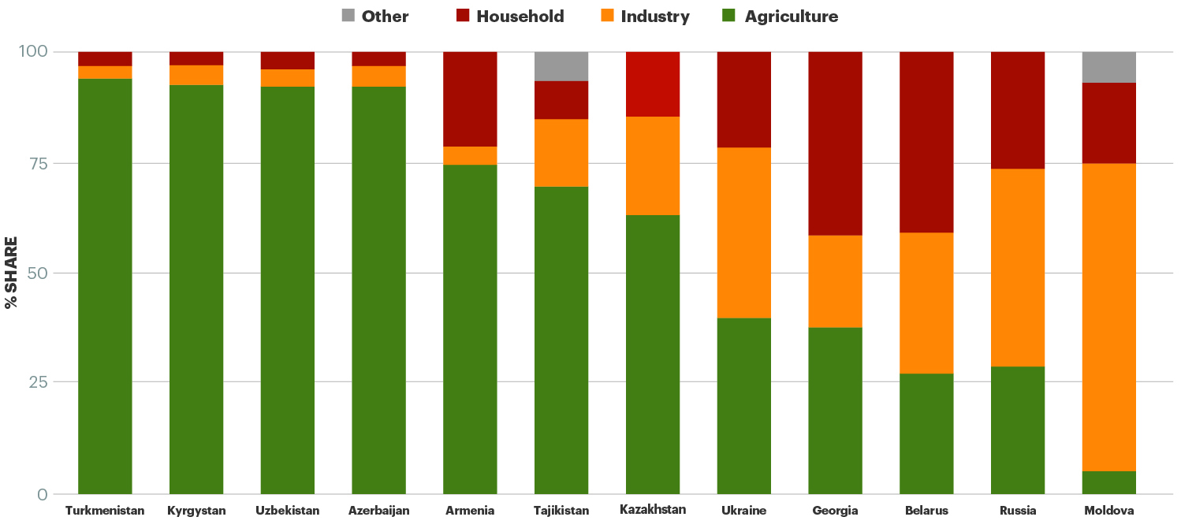
Water Consumption by Sector in Russia and Eurasia
Over 90% of water consumption in Turkmenistan, Azerbaijan, Uzbekistan and the Kyrgyz Republic is related to agriculture.
Source: World Bank; IEP Calculations

Slide 28
Natural Disasters
    Over 1.8 billion people live in subnational areas at extremely high risk of natural disasters.
    On average, the risk of natural disasters is highest in South Asian and Asia-Pacific countries.
    The percentage of UN Central Emergency Response Fund funding over the last three years pledged for assistance following a natural disaster is at the highest level since the fund was established.
    Sub-national areas facing severe natural disaster risk are clustered in East Africa, Southern Africa, and South-east Asia.
    There are 44 countries with both a high risk of natural disasters, and low resilience. These countries are home to more than four billion people.

Slide 29
Resilience and Natural Disaster Risk
There are 44 countries with low levels of Positive Peace and high levels of natural disaster risk.
Source: IEP Calculations

Slide 30
CERF Emergency Relief Funding Allocation
35% of CERF funding in the latest year was allocated to natural disaster relief.

Slide 31
Demographic Pressure
    Over 40% of the subnational areas in the ETR are expected to record population growth higher than 20% between now and 2050
    The majority of this population increase will occur in areas with low levels of peacefulness
    The 40 least peaceful countries will have an additional 1.3 billion people by 2050, at which point they will account for just under half of the total world population.
    Most countries in the world are transitioning to stable or contractionary population structures, as the number of young people relative to the number of old people continues to decline. The one exception is sub-Saharan Africa
    Total youth population growth in sub-Saharan Africa is so high that the number of people aged 15 or under in the region is projected to be higher than the entire population of Europe by 2050.

Slide 32
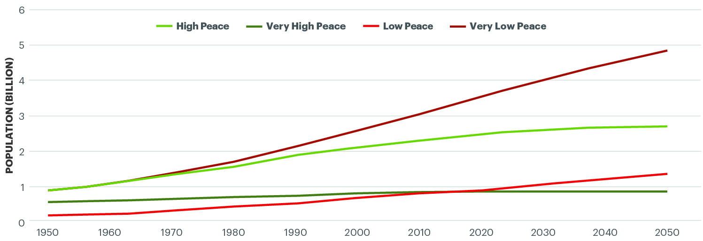
Projection of global population, by peace level, 1960–2050
Nearly five billion people are expected to be living in very low peace countries by 2050.
Source: IEP

Slide 33
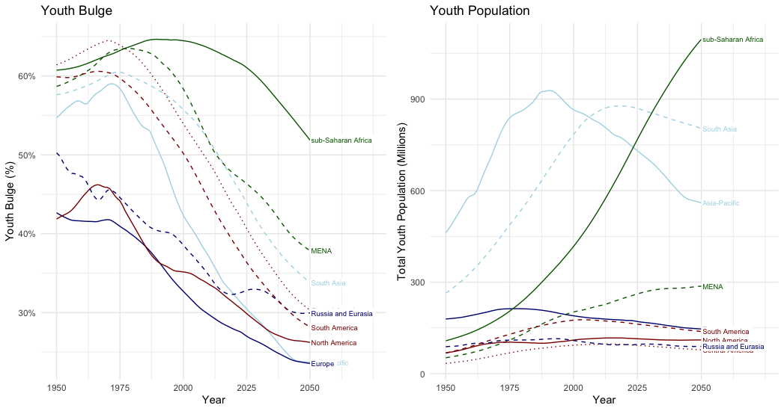
Youth Population, 1950-2050
Latest projection suggest there will be more than one billion young people in SSA by 2050.
Source: UN WPP; IEP Calculations

Slide 34
04.
Climate and Conflict

Slide 35
Climate and Conflict
    Shifts in ETR scores are associated with increased risk of conflict.
    A shift in domain score of 25% has the following impact:
      Increasing food insecurity increased the risk of conflict by 36%
      Increasing natural hazard exposure increased the risk of conflict by 21%
      Increasing water risk increased the risk of conflict by 18%
    Interstate conflict becomes more likely following rising temperatures or rainfall shocks, especially where states stand to lose from existing agreements on water sharing.
    Ecological threats have the biggest impact on conflict in regions like the Sahel, which face major deficiencies in governance, rule of law, high levels of poverty and short-term climatic variations.

Slide 36
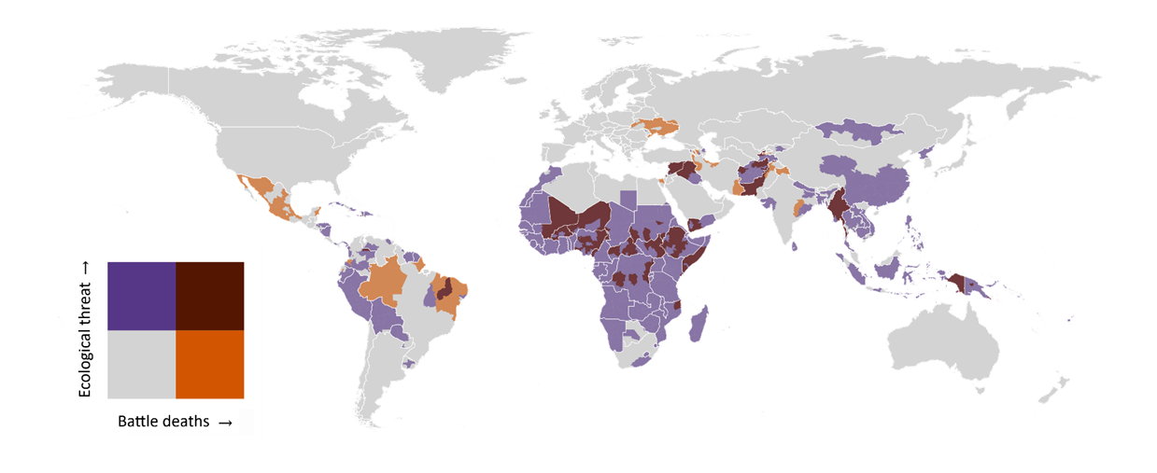
Subnational ecological threat score and conflict deaths, 2022
Most subnational regions with high levels of ecological threat and active conflict are in sub-Saharan Africa.
Source: UCDP; IEP Calculations

Slide 37
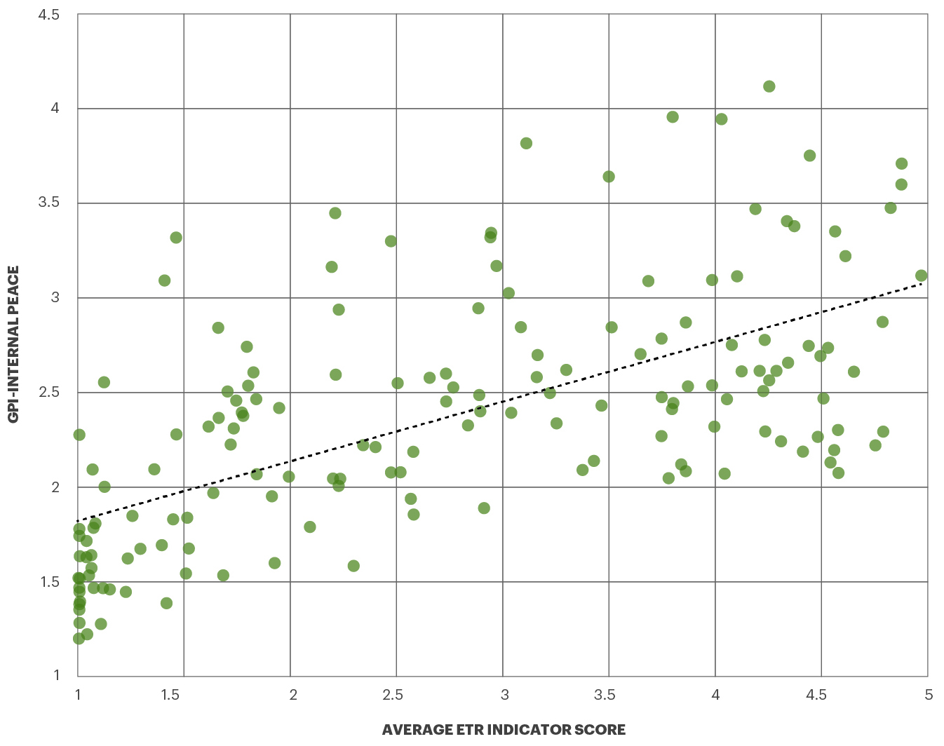
Average ecological threat score and internal peace, 2023 (r = 0.63)
The average country-level ecological threat score is highly correlated with internal peace as measured by the GPI.
Source: IEP Calculations

Slide 38
Disaster and Conflict Displacement
    The number of people displaced by conflict and natural disasters continues to rise
    The number of forcibly displaced people in the world now stands at over 108 million.
    More than 60 per cent of refugees and 80 per cent of internally displace people have moved to cities.

Slide 39
05.
Megacities and Migration

Slide 40
Megacities – currently 33, increasing to at least 50 by 2050
    The fastest growing cities face similar challenges – lack financial capacity, high rates of violence, civil unrest, pervasive pollution, poor sanitation, high population growth.
    More than 60% of current megacities are in low or very low peace countries. 268 million people live in very low peace megacities.
    The five most air polluted cities had readings 16 times higher than the WHO recommended annual limit. All five cities are in Asia.
    Most of the world’s megacity growth will take place in Africa and Asia. Eight of the ten largest megacities will be located in these regions in 2050.

Slide 41
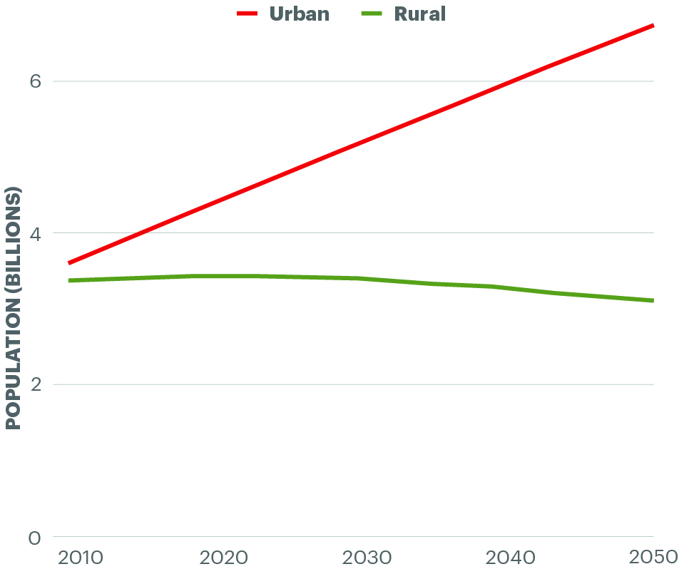
Projected population growth 2010-2050, urban versus rural
The world’s population is projected to continue to rise, with the growth occurring in cities, while rural areas will marginally decline.
Source: IEP; OWID; Masanobu Kii 2021

Slide 42
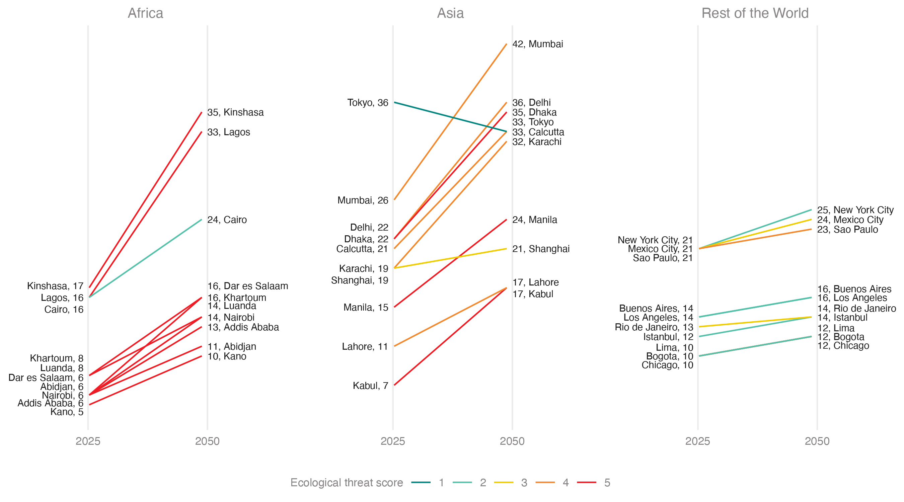
Megacity Growth, 2025 to 2050
Megacities with the largest expected growth have high levels of ecological threat.
Source: Global Cities Institute; IEP

Slide 43
2050 Megacity Population vs Country GDP Per Capita
The world’s most populous megacities in 2050 are all in countries with low GDP per capita.

Slide 44
06.
Policy Recommendations

Slide 45
Policy recommendations
    Current policies will not be enough to reverse the deteriorating environments of the poorest and least peaceful countries.
    The countries with the highest resilience will manage their way through current and emerging ecological shocks.
    Better analysis of the societal systems would enable better environmental outcomes.
    For the countries with the fastest population growth culturally appropriate family planning is urgently needed.
    Micro water capture projects aid the poorest. Enable food production, allowing micro value added businesses – cooperatives work well.
    Micro projects need stronger community design.
    Substantial improvements in bio-mass needed – FMNR cheap, successful and highly scalable.

Slide 46



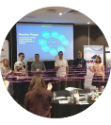

Get involved with IEP
@GlobPeaceIndex
GlobalPeaceIndex
Ambassador Program
Positive Peace Workshops
@GlobalPeaceIndex
Online
Strategic Partnerships
IEP Peace Academy
visionofhumanity.org

